Slide 1
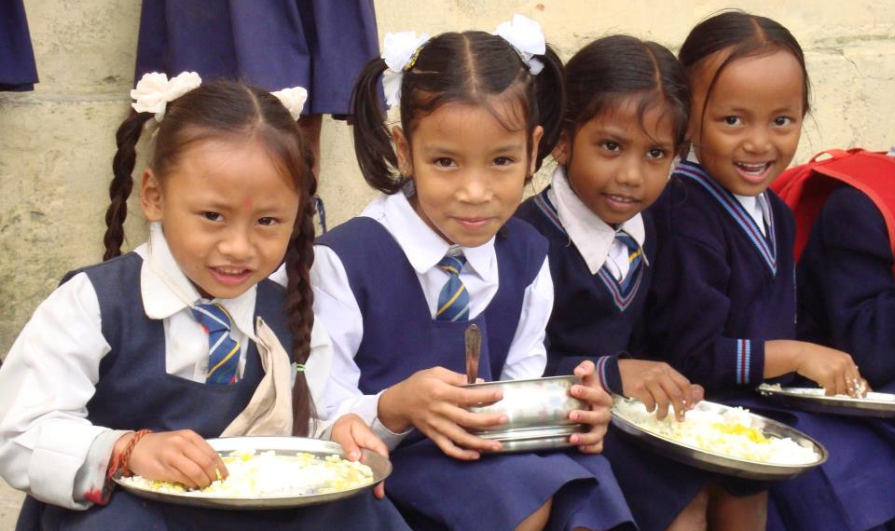
PAB - MDM Meeting for Review of Implementation of MDMS in NER States: 07.05.2019
Mid Day Meal Scheme

Slide 2
No. of Schools (Primary & U. Primary)
Name of States | PAB Approval | Coverage | %age
Arunachal Pradesh | 3182 | 2934 | 92%
Meghalaya | 11847 | 11715 | 99%
Mizoram | 2532 | 2532 | 100%
Nagaland | 2099 | 2099 | 100%
Sikkim | 864 | 868 | 100%
Tripura | 6568 | 6529 | 99%

Slide 3
Coverage of children (Primary & U. Primary)
Children (Pry) |  |  |  | Children (U.Pry)
State | PAB Approval | Covered | %age | PAB Approval | Covered | %age
Arunachal Pradesh | 115005 | 100132 | 87% | 60451 | 53830 | 89%
Meghalaya | 384583 | 383186 | 99% | 142408 | 142647 | 100%
Mizoram | 92114 | 87152 | 95% | 41336 | 39021 | 94%
Nagaland | 122117 | 123028 | 101% | 41584 | 40083 | 96%
Sikkim | 31348 | 29573 | 94% | 26676 | 24217 | 91%
Tripura | 233725 | 208157 | 89% | 134228 | 123521 | 92%

Slide 4
Working Days (Primary & U. Primary)
Name of State | Working Days (Pry) |  |  | Working Days (U.Pry)
 | PAB Approval | Covered | %age | PAB Approval | Covered | %age
Arunachal Pradesh | 220 | 219 | 99% | 220 | 219 | 99%
Meghalaya | 200 | 190 | 95% | 220 | 208 | 94%
Mizoram | 202 | 202 | 100% | 212 | 212 | 100%
Nagaland | 220 | 220 | 100% | 220 | 220 | 100%
Sikkim | 224 | 224 | 100% | 224 | 224 | 100%
Tripura | 230 | 226 | 98% | 230 | 225 | 97%

Slide 5
Engagement of Cook-cum-helpers (Primary & U. Primary)
State | PAB Approval | Engaged | %age
Arunachal Pradesh | 12856 | 12427 | 96%
Meghalaya | 18547 | 17997 | 97%
Mizoram | 5220 | 4894 | 94%
Nagaland | 4695 | 4695 | 100%
Sikkim | 1891 | 1881 | 99%
Tripura | 11028 | 11002 | 100%

Slide 6
Procurement of Kitchen devices (Primary & U. Primary)
State | PAB Approval | Procured | %age
Arunachal Pradesh | 8464 | 8464 | 100%
Meghalaya | 22163 | 22163 | 100%
Mizoram | 2548 | 2548 | 100%
Nagaland | 3547 | 3547 | 100%
Sikkim | 2198 | 1755 | 79%
Tripura | 11562 | 11562 | 100%

Slide 7
Construction of Kitchen-cum-stores (Primary & U. Primary)
State | PAB Approval | Constructed | %age
Arunachal Pradesh | 4085 | 4085 | 100%
Meghalaya | 9758 | 9491 | 97%
Mizoram | 2532 | 2506 | 99%
Nagaland | 2220 | 2220 | 100%
Sikkim | 948 | 940 | 99%
Tripura | 5304 | 5304 | 100%

Slide 8
Performance Grade Index (PGI)
Performance Grading Index (PGI):
Score against the weightage of 10 for indicator No. 1.3.7 i.e. “% of elementary school’s children taking MDM against target approved in PAB – in Govt. and aided schools”.
Score against the weightage of 10 for indicator No 1.3.8 i.e. “% of days Mid Day Meal served against total working days – Govt. and aided elementary schools.”
State | Score (children taking MDM) (1.3.7) out of 10 | Score (MDM served days ) (1.3.8) out of 10
Arunachal Pradesh | 9 | 10
Meghalaya | 10 | 10
Mizoram | 10 | 10
Nagaland | 10 | 10
Sikkim | 10 | 10
Tripura | 9 | 10

Slide 9
Performance Score Card – Arunachal Pradesh
Component | PAB-Approval (Target) | Achievement | % Achievement
Institutions | 3182 | 2934 | 92%
Children | 175456 | 153962 | 88%
Working Days | 220 | 219 | 99%
Food Grain Utilisation (in MTs) | 4524.99 | 3950.22 | 87%
Cooking Cost (Rs. in Lacs) | 1966.37 | 1677.70 | 85%
CCH Engaged | 12856 | 12427 | 97%
CCH Honorarieum (Rs. in Lacs) | 652.50 | 610.50 | 94%
TA (Rs. in Lacs) | 117.66 | 102.77 | 87%
MME (Rs. in Lacs) | 46.47 | 46.47 | 100%
Kitchen cum Store (KS) | 4085 | 4085 | 100%
Kitchen Devices (KD) | 8464 | 8464 | 100%
No. of Children's Health Check-up | 167565 | 106437 | 64%
Annual Data Entry | 3182 | 445 | 13%
Monthly Data Entry | 3182 | 0 | 0%
Ministry of HRD, Govt. of India

Slide 10
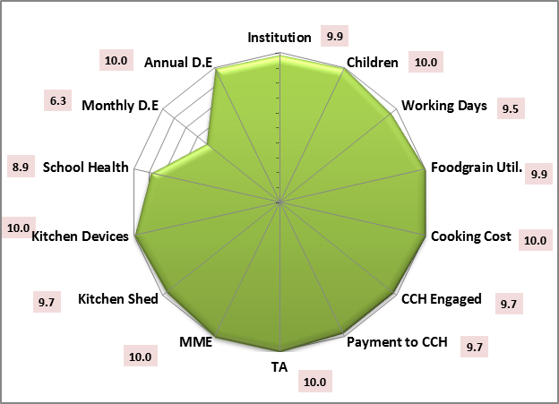
Performance score card-Meghalaya
Component | PAB-Approval (Target) | Achievement | % Achievement
Institutions (School) | 11847 | 11715 | 99%
Children | 526991 | 525833 | 100%
Working Days | 210 | 199 | 95%
Food Grain Utilization (in MTs) | 12391.12 | 12299.80 | 99%
Cooking Cost (Rs. in Lacs) | 5385.44 | 5369.37 | 100%
CCH Engaged | 18547 | 17997 | 97%
CCH Honorarium (Rs. in Lacs) | 1848.90 | 1790.98 | 97%
Transport Assistance (Rs. in Lacs) | 121.43 | 125.20 | 103%
MME (Rs. in Lacs) | 126.10 | 125.70 | 100%
Kitchen cum Store (KS) | 9758 | 9491 | 97%
Kitchen Devices (KD) | 22163 | 22163 | 100%
No. of Children's Health Check-up | 604583 | 540599 | 89%
Annual Data Entry | 10713 | 10695 | 100%
Monthly Data Entry | 10713 | 6751 | 63%

Slide 11
Performance Score Card – Mizoram
Component | PAB-Approval (Target) | Achievement | % Achievement
Institutions (School) | 2532 | 2524 | 100%
Children | 133450 | 126173 | 95%
Working Days | 207 | 207 | 100%
Food Grain Utilisation | 3175.19 | 3001.36 | 95%
Cooking Cost (Rs. in Lacs) | 1490.33 | 1477.70 | 99%
CCH Engaged | 5220 | 4894 | 94%
CCH Honorarieum (Rs. in Lacs) | 783.00 | 737.86 | 94%
TA (Rs. in Lacs) | 116.31 | 116.31 | 100%
MME (Rs. in Lacs) | 34.47 | 34.47 | 100%
Kitchen cum Store (KS) | 2532 | 2506 | 99%
Kitchen Devices (KD) | 2548 | 2548 | 100%
No. of Children's Health Check-up | 2232 | 1830 | 82%
Annual Data Entry | 2532 | 2524 | 100%
Monthly Data Entry | 2532 | 2524 | 100%
Ministry of HRD, Govt. of India

Slide 12
Performance Score Card – Nagaland
Component | PAB-Approval (Target) | Achievement | % Achievement
Institutions (School) | 2099 | 2099 | 100%
Children | 163701 | 163111 | 100%
Working Days | 220 | 220 | 100%
Food Grain Utilisation (in MTs) | 4021.66 | 4015.80 | 100%
Cooking Cost (Rs. in Lacs) | 1817.20 | 1695.06 | 93%
CCH Engaged | 4695 | 4695 | 100%
CCH Honorarium (Rs. in Lacs) | 601.00 | 601.00 | 100%
TA (Rs. in Lacs) | 469.10 | 469.10 | 100%
MME (Rs. in Lacs) | 40.33 | 40.33 | 100%
Kitchen cum Store (KS) | 2220 | 2220 | 100%
Kitchen Devices (KD) | 3547 | 3547 | 100%
No. of Children's Health Check-up | 2099 | 1057 | 50%
Annual Data Entry | 1983 | 1749 | 88%
Monthly Data Entry | 1983 | 1491 | 75%
Ministry of HRD, Govt. of India

Slide 13
Performance Score Card - Sikkim
Component | PAB-Approval (Target) | Achievement | % Achievement
Institutions (School) | 864 | 868 | 100%
Children | 58024 | 53790 | 93%
Working Days | 224 | 224 | 100%
Food Grain Utilisation (in MTs) | 1598.54 | 1598.54 | 100%
Cooking Cost (Rs. in Lacs) | 688.35 | 635.97 | 92%
CCH Engaged | 1891 | 1881 | 99%
CCH Honorarieum (Rs. in Lacs) | 189.10 | 188.10 | 99%
TA (Rs. in Lacs) | 29.09 | 29.09 | 100%
MME (Rs. in Lacs) | 14.87 | 14.87 | 100%
Kitchen cum Store (KS) | 948 | 940 | 99%
Kitchen Devices (KD) | 2198 | 1755 | 79%
No. of Children's Health Check-up | 60691 | 42480 | 70%
Annual Data Entry | 868 | 868 | 100%
Monthly Data Entry | 868 | 850 | 98%
Ministry of HRD, Govt. of India

Slide 14
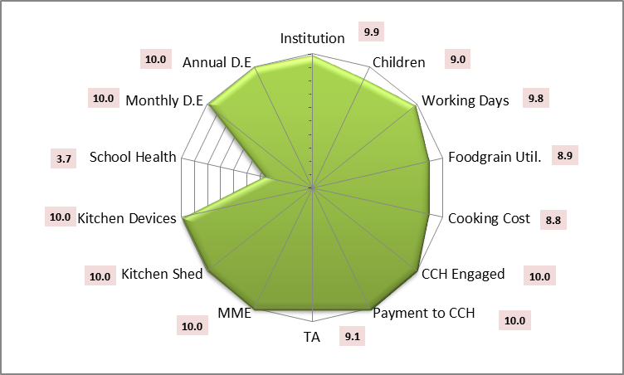
Performance score card-Tripura
Component | PAB-Approval (Target) | Achievement | % Achievement
Institutions (School) | 6568 | 6529 | 99%
Children | 367953 | 331678 | 90%
Working Days | 230 | 226 | 98%
Food Grain Utilization (in MTs) | 10006.55 | 8873.18 | 89%
Cooking Cost (Rs. in Lacs) | 4389.19 | 3883.89 | 88%
CCH Engaged | 11028 | 11002 | 100%
CCH Honorarium (Rs. in Lacs) | 1654.20 | 1650.30 | 100%
Transport Assistance (Rs. in Lacs) | 189.12 | 171.43 | 91%
MME (Rs. in Lacs) | 96.75 | 96.75 | 100%
Kitchen cum Store (KS) | 5304 | 5304 | 100%
Kitchen Devices (KD) | 11562 | 11562 | 100%
No. of Children's Health Check-up | 446226 | 163605 | 37%
Annual Data Entry | 6529 | 6529 | 100%
Monthly Data Entry | 6529 | 6529 | 100%

Slide 15
Focus of this year

Slide 16
Focus of this year

Slide 17
Focus of this year
Usage of Jails, Temples, Gurudwaras etc. for Mid Day Meal:
Temples, Gurudwaras, Jails etc. can be involved in Mid Day Meal Scheme.
Temples, Gurudwaras have greater reach among community, this can help in wider publicity for Mid Day Meal Scheme.
Temples, Gurudwaras can adopt some schools for providing meals.
Enhanced sense of ownership of the Mid Day Meal Scheme among the local community.
Uploading of videos, testimonials on Shagun web-portal:
Shagun web-portal is an innovation for repository of best practices which collates videos, testimonials, case studies and images of state-level innovations and success stories.
Accordingly, relevant videos, testimonials of the innovative activities being carried out by States/UTs related to Mid Day Meal may be shared with this department so that the same may be uploaded on Shagun (https://repository.seshagun.nic.in) repository after necessary approvals.

Slide 18
Tithi Bhojan
Tithi Bhojan, is a community participation programme initiated by Gujarat.
Community provides full meal or additional items on special occasions, birthdays, marriages, anniversaries, days of national importance and other festivals etc.
Ministry of Human Resource Development has issued Guidelines on Tithi Bhojan on 26th October, 2018 to all the States and UTs.
Tithi Bhojan has been adopted by the States & UTs of Assam (Sampriti Bhojan), Andhra Pradesh, Punjab (Priti bhojan), Dadra & Nagar Haveli (Tithi Bhojan), Daman & Diu (Tithi Bhojan), Karnataka (Shalegagi Naavu Neevu), Madhya Pradesh, Maharastra (Sneh Bhojan), Chandigarh (Tithi Bhojan), Puducherry (Anna Dhanam), Haryana (Beti ka Janamdin) and Uttarakhand (Tithi Bhojan).

Slide 19
Automated Monitoring System
1
AMS is used to monitor MDMS on real time basis.
2
Schools need to share the daily data on number of meals and reasons if meals are not served.
3
States/UTs are using various technologies (SMS/ IVRS/ Mobile App) for daily data collection.
Graphical dashboard: Reports are generated and displayed online
4
5
Drill down reports from State to school level are available
6
Daily email alerts are sent to States and UTs level regarding implementation of AMS.
19

Slide 20
Status of implementation of MIS & AMS

Slide 21
Amendment for involvement of Centralized Kitchens only in urban areas.
Amendment of the Gazette of India notification dated 18th April, 2019 stated that:
In the MDM Rules 2015, in rule 5 for sub-rule (2) the following sub-rule shall be substituted
“(2) Every school shall have the facility for cooking meal in hygienic manner. Schools in urban areas may use the facility of centralized kitchens for cooking meals wherever required in accordance with the guidelines issued by the Central Government and the meal shall be served to the children at respected school only”

Slide 22
Status of flow of funds from State to school
Name of State | Delay in release of fund from State to District / School
Arunachal Pradesh | 6 months
Meghalaya | Timely
Mizoram | 3 months
Nagaland | 2 months
Sikkim | 1 month
Tripura | 1 month

Slide 23
Focus of this year

Slide 24
Social Audit- Mid Day Meal Scheme
“Social audit" means the process in which people collectively monitor and evaluate the planning and implementation of a programme or scheme.
Importance:
Helps to ensure accountability and participation of all the stakeholders in the implementation of Mid Day Meal Scheme
It creates a sense of ownership and increases the reach of the scheme up to the beneficiaries.
Social audit enables the State Governments to identify and resolve gaps in the implementation of Mid Day meal Scheme.
Status :
Social Audit carried out in Uttarakhand and Tripura in 2018-19.
Social intervention for Community Participation under MDMS

Slide 25
Recommendations
S. No | State | PAB Approval for FY 2018-19 (Rs. in Lakhs) | Proposal for FY 2019-20 (Rs. in Lakhs) | Recommendations for FY - 2019-20 (Rs. in Lakhs)
1 | Arunachal Pradesh | 2566.67 | 2818.67 | 2818.67
2 | Meghalaya | 6890.75 | 7775.43 | 7775.43
3 | Mizoram | 2016.49 | 2169.52 | 2169.52
4 | Nagaland | 2254.08 | 3862.21 | 3862.21
5 | Sikkim | 877.97 | 939.80 | 939.80
6 | Tripura | 5391.61 | 6227.74 | 6227.74
Ministry of HRD, Govt. of India

Slide 26
Thank you

